Slide 1


Programming
Mr Butler | Year 10 ICT

Slide 2
What is programming?
Programming is everything involved in making, controlling and communicating with digital devices.
Programming is often called ‘coding’, as it involves writing a language that computers can understand. This allows us to develop devices, apps and technology in our own way.
A programmer is a person who writes code for a device and is also involved in testing the code to ensure it is fully functional.

Slide 3


Q1
Who is considered to be the first ever computer programmer?

Slide 4
Q2
How many programming languages are there to use?

Slide 5
Q3
What jobs can you get from knowing programming?

Slide 6
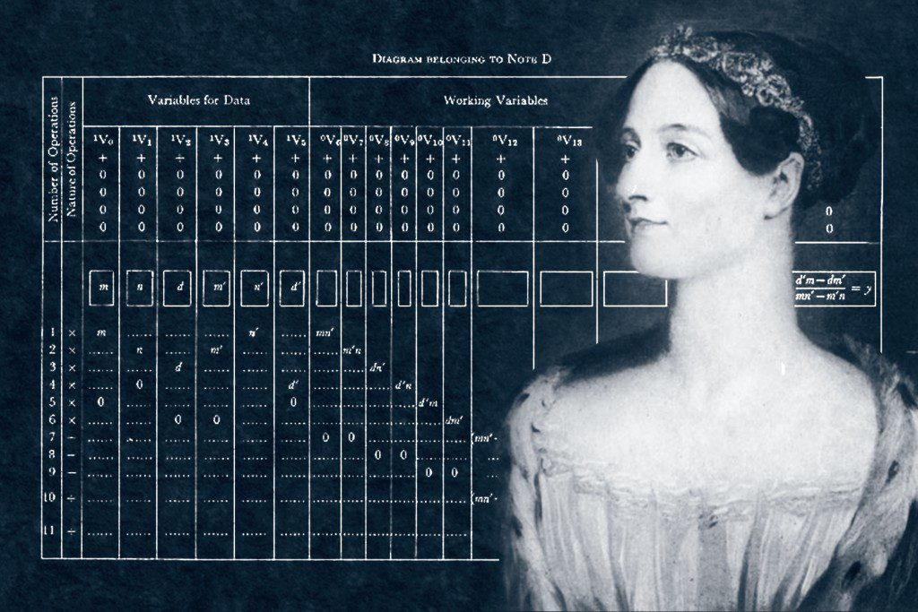
Ada Lovelace
Ada Lovelace is famous for being the first computer programmer.
Worked with Charles Babbage, as Babbage proposed the first general-purpose computer called the Analytical Engine.
Devised the first algorithm intended to be carried out by the machine past pure calculation.
Cited as the first computer programmer for this reason

Slide 7
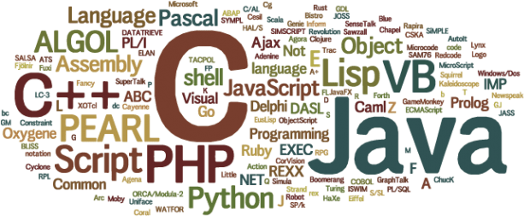
The different programming languages
There are roughly 700 programming languages used today.
These all have different uses and use cases
Some are very good for:
  App development
  Web development
  Phone/tablet development
  Operating system development
  Software Development
Programming languages appear for different jobs as each have their own features, benefits and characteristics suitable for different things.

Slide 8

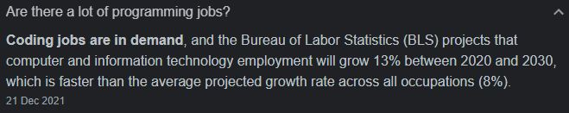

The Jobs Of Programming
We all want a well paid job
Jobs in IT are developing and have developed considerably every year.
IT jobs are going to make you a LOT of money.
See this number?
Whilst #13 in highest paying jobs, the projected number of jobs far exceeds anything above it. In fact, the other projected jobs above this are reducing by hundreds!
Source: https://money.usnews.com/careers/best-jobs/rankings/best-paying-jobs

Slide 9

JOBS IN IT/PROGRAMMING
There are so many jobs in IT, including:
Software engineer
Network architects
IT Project managers
Database Administrators
Web Developers
System Analyst
Mobile App Developer
IT Consultant
Technical Sales Rep
Support Analyst
Cyber Security Specialist
Social Media Manager
------------------------------------------------------------------------
Medicine/Dentistry – The analysis skills help!
Army – The problem solving is perfect!
Analyst – Literally analysing everything!
Marketer – All of the above!

Slide 10

WHY LEARN PROGRAMMING?
Not only does it allow you to give machines instructions, but it also teaches you abstract thinking, pattern recognition and problem-solving
These are key skills you will use over the rest of your life.
  Abstract thinking: ability to work with concepts rather than physical things
  Pattern recognition: ability to see relationships and consequences from actions that haven’t happened yet
  Problem solving: ability to find solutions to everything and anything, and be able to think outside the box in many situations (also known as forward thinking)

Slide 11
The Many Uses of Programming
Think of all the different computing devices you have used – phones, tablets, computers, gaming consoles, docking stations, credit card readers.
All of these had to be designed, developed, tested and produced in the first place. The role of a computer programmer is to design, write and test the underlying code within these devices to make them work!
TASK
Pick a device you have at home. Find out who designed the device and programmed it. Create a small credit card sized business card for this person, company or group of people.

Slide 12
What programming do we already know?
In ICT class, we have used:
  Scratch – drag and drop event programming
  BBC Microbits – drag and drop event programming
  HTML/Web Development – The first introduction to a lot of computational thinking happened here
In wider school, you would have used:
  Methods in Science (SEQUENCING)
  Made decisions in Art (SELECTION)
  Used count-controlled loops and condition-controlled loops in PE (REPETITION)
It is now time for you to put this altogether and learn a programming language!

Slide 13
Let’s Learn a great programming language – C#
C# is a high-level language, which means it is very close to ‘human readable English’
Other programming languages are low level languages, and these are close to looking like 1’s and 0’s (binary)
A compiler is the computer program that converts our ‘human code’ into the binary code computers can understand – we don’t usually write in binary.

Slide 14
How are we going to learn C#?
As we know from KS3, virus’ are small pieces of code written to damage the operation of a computer, steal data or corrupt data.
C2K, who manage our computers, try to ensure they are as secure as possible and so limit what we can code on computers. At GCSE we can use a virtual machine which allows us to code without the risk of breaking school computers.
This year, however, we are going to use an online tool to learn C#.

Slide 15
What can C# do?
C# is an elegant object-orientated language that enables developers to build a variety of secure and robust applications that run on the .NET Framework.
For example, the mobile game Pokemon Go and the Stack Overflow website were built with frameworks that can be run with C# (Unity and ASP.NET, respectively).
You can use C# to create Windows applications, Web services, mobile applications, and much much more

Slide 16
Quick Question: C# applications run:
A: Only on Linux
C: Using Java
B: on the .NET Framework
D: None of these
Notes:
Ans: B

Slide 17
Why use a strongly typed language like C#?
While it means writing more code, using types has long term benefits like built-in documentation and increased readability.
It also allows us to use an extensive intellisense – which basically is predictive text when you are writing code.
Intellisense will also offer you help with debugging as it knows what can and can’t happen with a data type before you even try to run your code!

Slide 18

Mastering C# with Visual Studio
A Journey from Block Programming to Professional Code

Slide 19

Think Like a Programmer
From Scratch to C#
You have used Scratch to drag and drop blocks. Programming is just the path from an idea to a solution.
C# (pronounced 'C-Sharp') is a professional language used by companies like Microsoft, NASA, and game developers using Unity.
It’s the primary language used to build almost every game you see made in the Unity Engine, including Pokemon Go and Among Us.

Slide 20

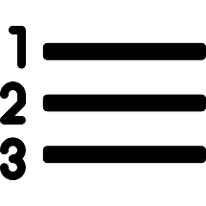



What is Visual Studio?
To write C#, we use an Integrated Development Environment (IDE) called Visual Studio.
Allow a programmer to view, write, test and run code
Features Include
    Line numbering helps programmers distinguish between lines in long programs (Very helpful in debugging)
    Colour coding of keywords: Also different coloured underlines – red underline, for example, displays a syntax error
    Clipboard (for copy + paste)
    Collapsible code sections: Makes viewing large programs easier

Slide 21

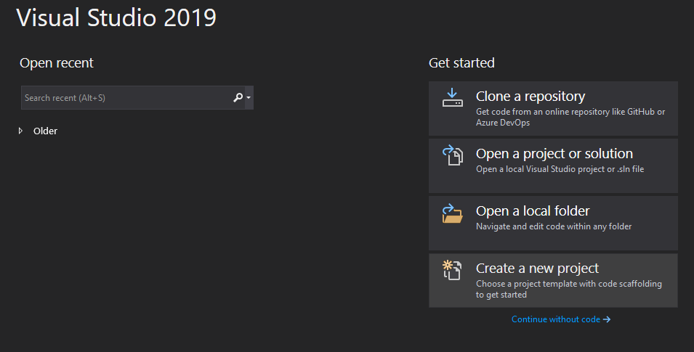
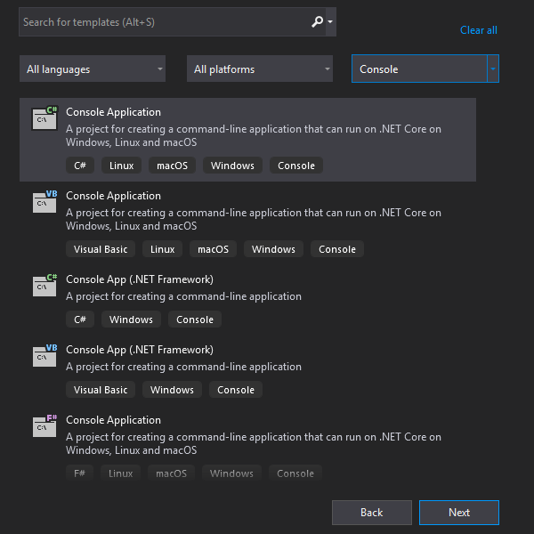
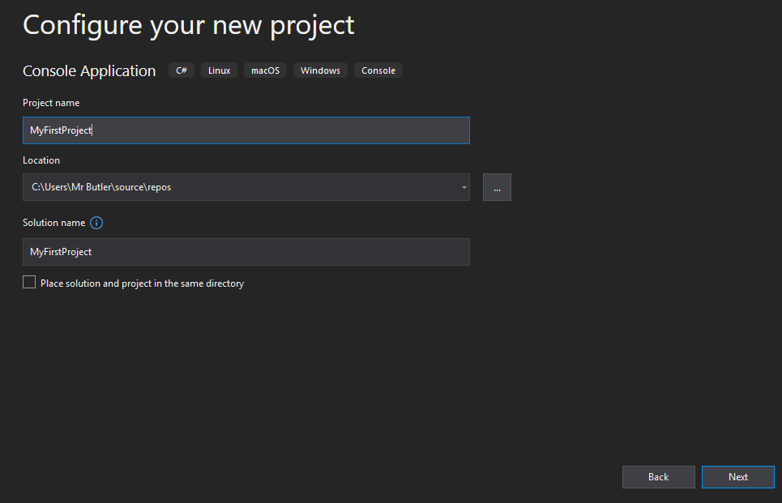
Starting Your First Project
A Console application uses a text-only interface. We chose this type of application to focus on learning the fundamentals of C#.
Choose a Console Application to create a simple, text-based program.
1
Select Create a new Project
3
2
Enter a project name (no spaces) and click Create.
Template: Select Console Application – ensure it is the C# version!

Slide 22
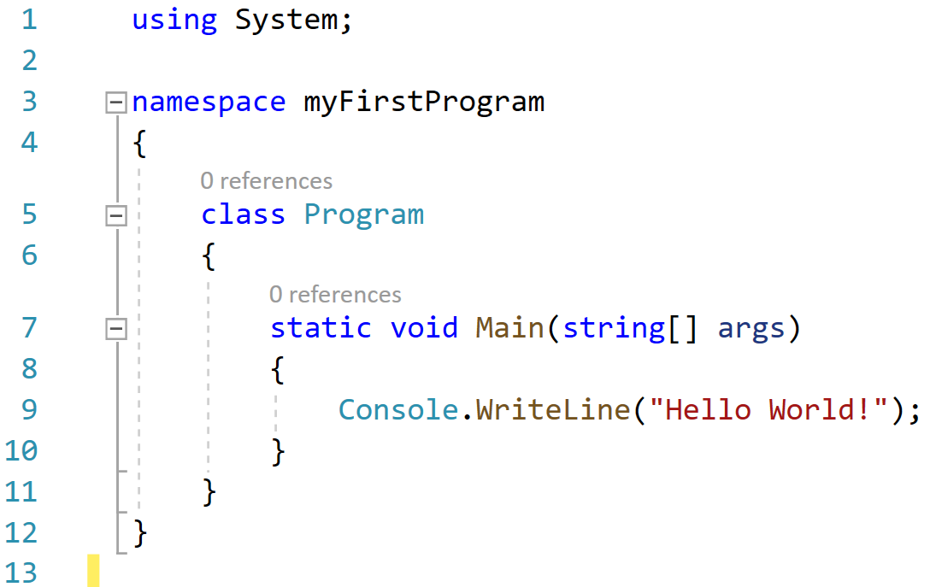
A Program Structure
We’re not going to go into too much detail here, but we just need to know the basics.
I like to think of this like an author of a series of books.
This basically says “we’re going to be using some premade tools”
This section is like the name of my book series.
The { shows where the book series starts, and the } shows where the book series ends.
This is one book in my series.
The { starts this specific book, and the } shows where that book ends.
Notice how it starts and ends within the series.
This is a chapter within the book. Every chapter starts with this Main method.
The first sentence.

Slide 23
The Magic Command
To make text appear on the screen, we use this command:
object
line terminator
method
message
🚧 Remember
Every instruction must end with a semicolon (;). It is like a full stop at the end of a sentence in English.

Slide 24

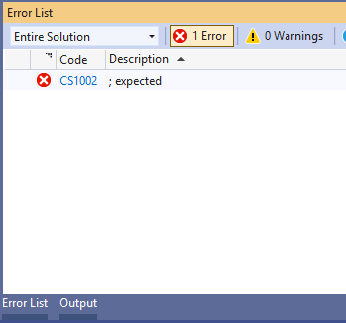
Running Your Code
How to Start
To run your program, look for the Green Play Button at the top that says 'Start' or your project’s name.
If you see errors in the 'Error List' at the bottom, your program won't run. Treat errors as clues to a puzzle!
This error tells you that you’re missing a semi colon!
Q. Where does the semicolon go?

Slide 25

Challenge: Personalise it
📖 Example
Console.WriteLine(“I Like Coding”);
Level 1
Display your Full Name.
Level 2
Display your Favourite Food.
Level 3
Display your Favourite Sport.

Slide 26
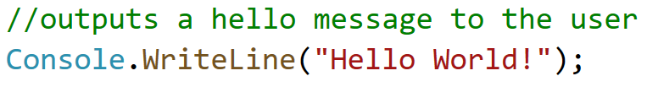
Adding a Comment
In programming, we often want to be able to add explanations to our code, often allowing other programmers see what a piece of code is doing.
The computer needs w way to know the text you are writing is a comment, so we add // to the start to tell the computer this is commentary. For example:

Slide 27

Key Terms Review
Console |  | The software where we write code (eg. Visual Studio)
Syntax |  | The character used to end a statement in C#.
Semicolon |  | The text-based window where our program output appears.
IDE |  | The set of rules defining how code must be written.

Slide 28

The Box Analogy
Variable name
[data type]
Variables are like Boxes
Think of a variable as a storage box in the computer's memory. To use it, you need two things:
A Name: This is the variable name or what the box is labelled as.
A Data Type: This determines what can fit inside the box (e.g., an integer or text).
🚧 Remember
You must define the data type in C# before you can put anything in the box!

Slide 29



The Big Three Data Types
In C#, we must specify the data type being stored. Here are the most common types:
string
int
Used for text. Must be wrapped in double quotes ( “ and ” ), like “Hello World!”
double
Short for Integer. Used for whole numbers like 10, -5, or 1,000,000.
Used for decimals. Perfect for precise values like 3.14 or 99.99

Slide 30
Match the Data!
string |  | A named container for data.
int |  | A whole number like 25.
double |  | A decimal number like 1.75.
variable |  | Textual data like “Steve”.

Slide 31

Declaring & Assigning
50
The Syntax
To create a variable, follow this pattern:
score
[int]
data type
variable name
value
🚧 Remember
Don’t forget the semicolon (;) at the end of the statement. It tells the computer the instruction is finished.

Slide 32
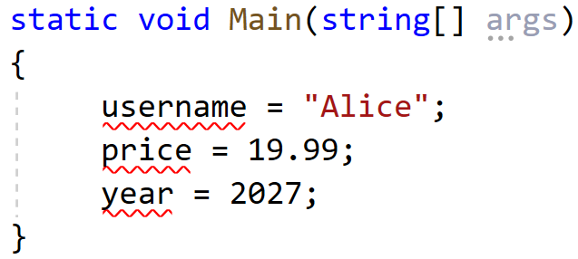
Fix the code
Below is a screenshot of Tom, who is trying to declare three variables.
Correct the code by entering in a suitable data type for each variable
🚧 Remember
Declaring variables always start with stating the data type first! i.e.
int age = 41;

Slide 33

Displaying Your Data
Console.WriteLine()
You can combine text and variables using the + symbol (this is called concatenation).
If the variable is declared as
Writing
Will output

Slide 34
Coding Challenge: Digital ID Card
The Task
Write a program storing profile information in variables, then print it.
These all need to be stored in variables
📖 Example
Goal Output:
My Name is Alex.
I am 15 years old.
I am 1.8m tall.
My Favourite sport is Rugby.
📘 Extension
Goal Output:
My Name is Alex.
I will be 25 years old in 10 years time.
I am 1.8m tall.
My Favourite sport is Rugby.

Slide 35

Why Bother with Data Types
If we could just make every variable a 'string', why does C# force us to use 'int' and 'double'? What would happen if we tried to add two 'strings' together like "10" + "10"?
You might have said...
Computers process numbers (int/double) differently than text (string).
If we use string for numbers, we can't do maths properly (e.g. "10" + "10" would result in "1010", not 20).
Using specific types saves memory and prevents errors in complex calculations.

Slide 36
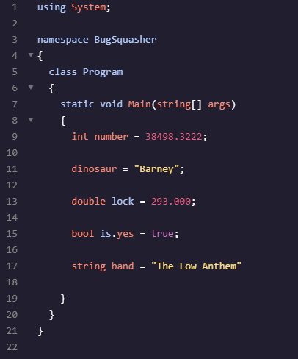
Activity: What’s wrong here then?
TASK
There are 5 errors in this code snippet. Copy out this snippet and highlight/circle the errors.
Annotate how or what the correct solution should be!

Slide 37
Solutions
There are 5 errors in this code snippet. Copy out this snippet and highlight/circle the errors.
Annotate how or what the correct solution should be!
An integer (int) must be a whole number
A variable must be declared with a specific type
A double can only have 2 decimal places
A variable name cannot have a full stop/symbol
A statement must end with a semi colon (;)
Mark yourself out of 5!

Slide 38
Making Programs Interactive in C#
Imagine a world where apps didn't listen to you.
No search bars, no login screens, and no game controls. Boring, right? To make software useful, we need to gather data from the user and react to it.
🔑 Key Point
Interactive programs follow a simple flow:
Input 👉 Process 👉 Output

Slide 39
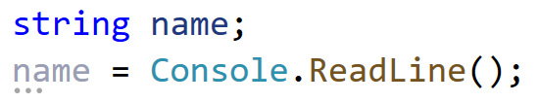
Capturing Data with Console.ReadLine()
Use Conosle.ReadLine() to pause the program until the user types text and presses Enter.
name
[string]
The Program waits for user input
🔑 Remember
Console.ReadLine() always returns data as a ‘string’, even if the user types in a number

Slide 40
Check Yourself (before you wreck yourself!)
To store a person’s name, you first declare a ____________ variable, then use ________________ to capture their typing.
If you wanted to store their age, you would declare a variable called age with a data type of _________________.
To output the value stored within a variable, you would use the _________________ method.
string
Console.ReadLine()
int
Console.WriteLine()
Word Bank
String Console.WriteLine() int Console.ReadLine()

Slide 41
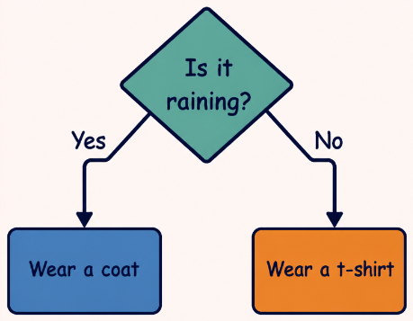
Making Choices: The IF Statement
Logic is about choices.
An IF statement tells the computer to run a block of code only if a specific condition is true. If it isn't true, we can use to provide a backup plan.
==
Checks if two values are equal
> and <
Checks if two values are greater or less than

Slide 42
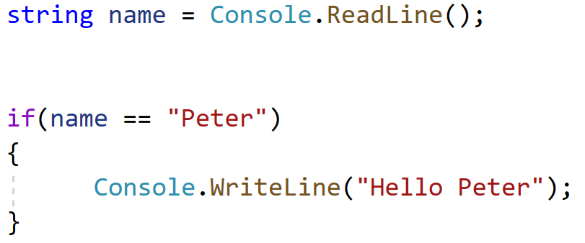
Code Structure: Input + Logic
⚠️ Watch Out!
Unlike in Maths, C# uses double equals sign (==) to compare things. A single equals sign (=) is only for assigning values.
The Code Pattern
Within the brackets goes the condition
If the condition is true, then the code within the { and } runs.

Slide 43

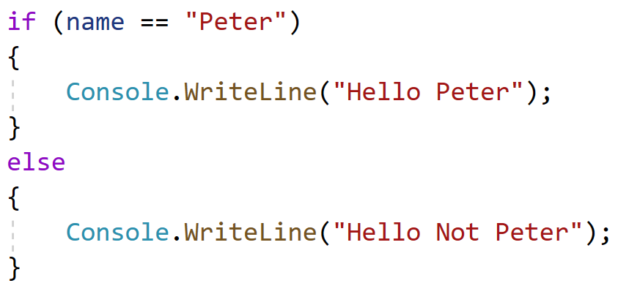
The IF statement can also have an optional attachment called the ELSE statement.
It runs if the condition false

Slide 44
Operator Check
In C#, the code if(age = 18) is the correct way to check if someone is 18
👍
👎
TRUE
FALSE

Slide 45

Building a “Choose your Path” Story
Using what you've learned, create a mini-adventure. Ask the user: 'Do you go Left or Right?'
Capture their choice in a variable.
Use an IF statement to print a different outcome for each path.

Slide 46


Challenge: The Age Checker
Can you solve this?
Write a program that asks for a user's age.
Use the operator to tell them if they are old enough to drive (17+ in the UK) or vote (18+).
🔑 Key Tip
To compare ages, you might need to convert the input using Convert.ToInt32()
But for now, try comparing string like if (age == “18”)

Slide 47
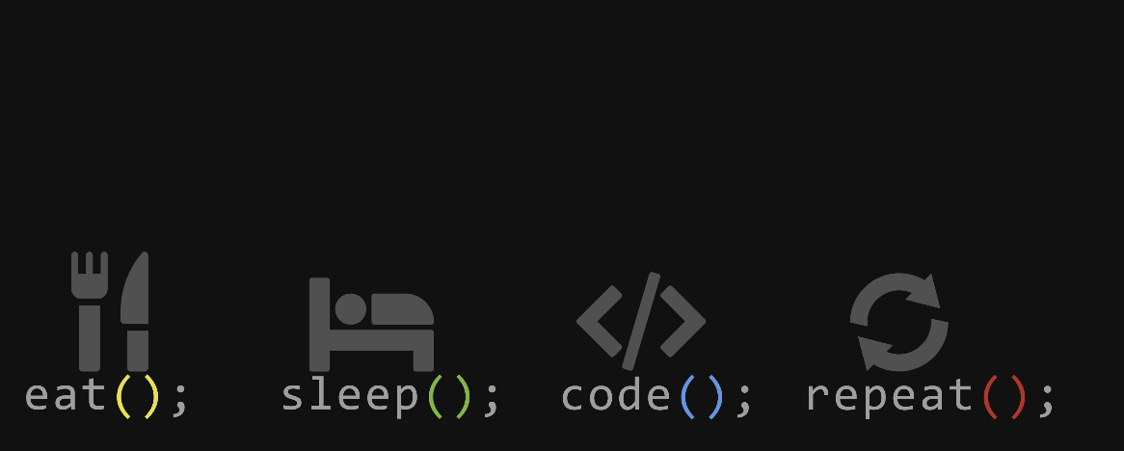
The Power of Repetition
Why do we need loops?
Imagine writing a program to print 'Hello World' 1,000 times. You could copy and paste 1,000 lines, but what if you needed to change the message later?
Loops allow us to write a block of code once and run it as many times as needed.
📖 Key Point
Loops make code shorter, easier to read, and much more maintainable. This is the ‘DRY’ principle:
Don’t Repeat Yourself

Slide 48
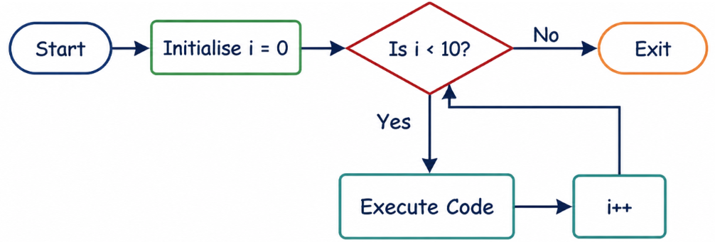
The FOR Loop Structure
A For loop is used when you know exactly how many times you want to repeat a task – this is called a count-controlled loop. It uses a counter to keep track of the repetitions.
This is a fancy looking piece of code. But all it does is increase (increment) i by 1.

Slide 49
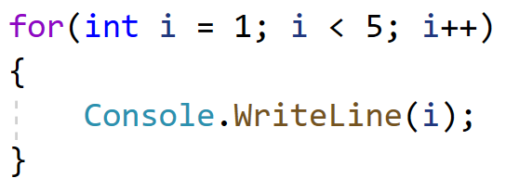
Anatomy of a For Loop
In C#, the for loop has three parts:
Initialiser: Where the counter starts (e.g., int i = 0).
Condition: How long to keep going (e.g., i < 10).
Iterator: How to update the counter (e.g., i++).
Initialiser
Where the counter starts
Condition
How long to keep going
📖 Example
Printing 1 to 5:
Iterator
How to update the counter

Slide 50
Check your Knowledge!
Which part of the for loop defines when the loop should stop running?
Which part of the for loop defines the counter?
Which part of the for loop increases the counter after each repetition?
The Initialiser
The Condition
The Iterator
The Curly Braces
The Initialiser
The Condition
The Iterator
The Curly Braces
The Initialiser
The Condition
The Iterator
The Curly Braces

Slide 51
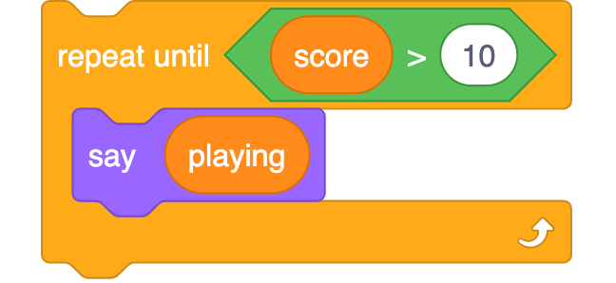
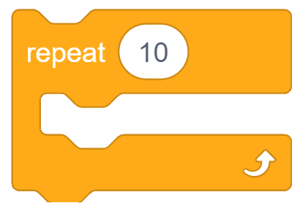
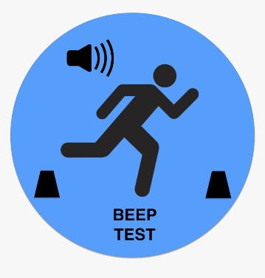
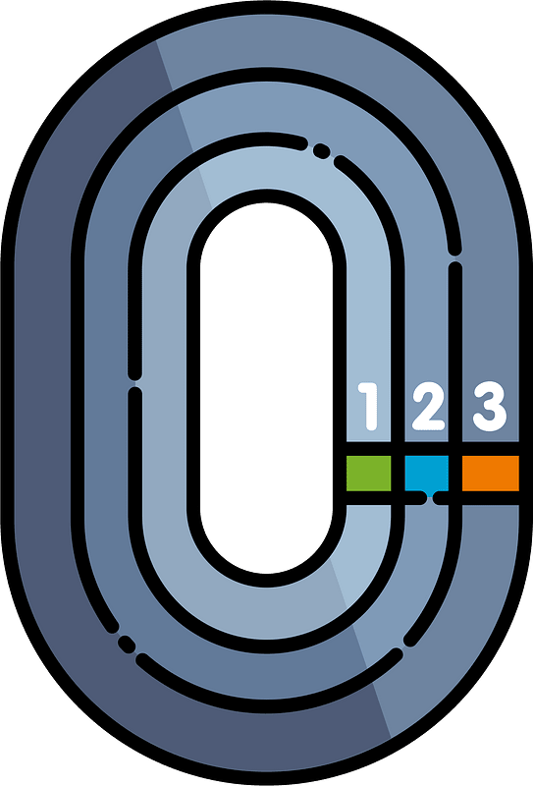
Going around in circles? MORE LOOPS?
The FOR Loop
This is best for definite iteration, where we know how many times we want to repeat.
The WHILE Loop
This is best for indefinite iteration, where we don’t know how many times it will run – like waiting for a user to enter the correct password
⚠️ Watch Out!
Scratch doesn’t actually have an explicit “WHILE” loop, so this repeat until loop actually does the opposite – when the condition becomes true.

Slide 52
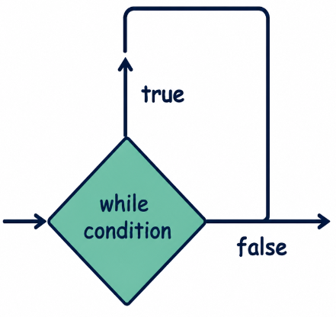
Anatomy of a While Loop
The while loop checks a condition before executing the code block. If the condition is true, the code runs, then it checks again.
Logic Flow
Check Condition
Run Code (if true)
Repeat until false
condition
Until this is false, the program will keep looping

Slide 53
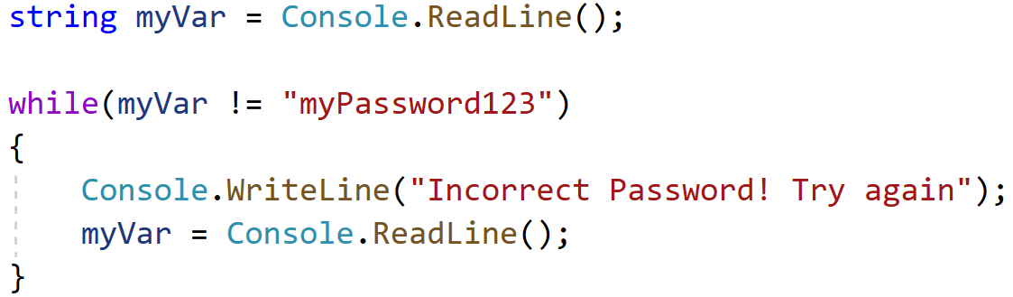
The WHILE loop is fairly straightforward to write, as it looks a lot like the if statement we learnt previously. This time, however,
📖 Key Point
!= means not equals to (≠) in C#
We don’t know how many times the user will enter in the password incorrectly, but this will repeat until the user enters in the correct password

Slide 54
Choosing the Right Tool
A key skill in programming is knowing when to use a For Loop (definite iteration) and when to use a While Loop (indefinite iteration).
Read the scenarios below. Decide which loop type is best and briefly explain why.
Scenario | Loop Type & Reason
Printing the 12 times table for a specific number.
Waiting for a user to type in the correct password to log into a computer system.
A game where a player keeps guessing a secret number until they get it right.
For Loop (We know exactly how many times it needs to run - 12 times)
While Loop (We don't know how many attempts the user will take)
While Loop (We don't know how many guesses it will take before the condition becomes true)

Slide 55
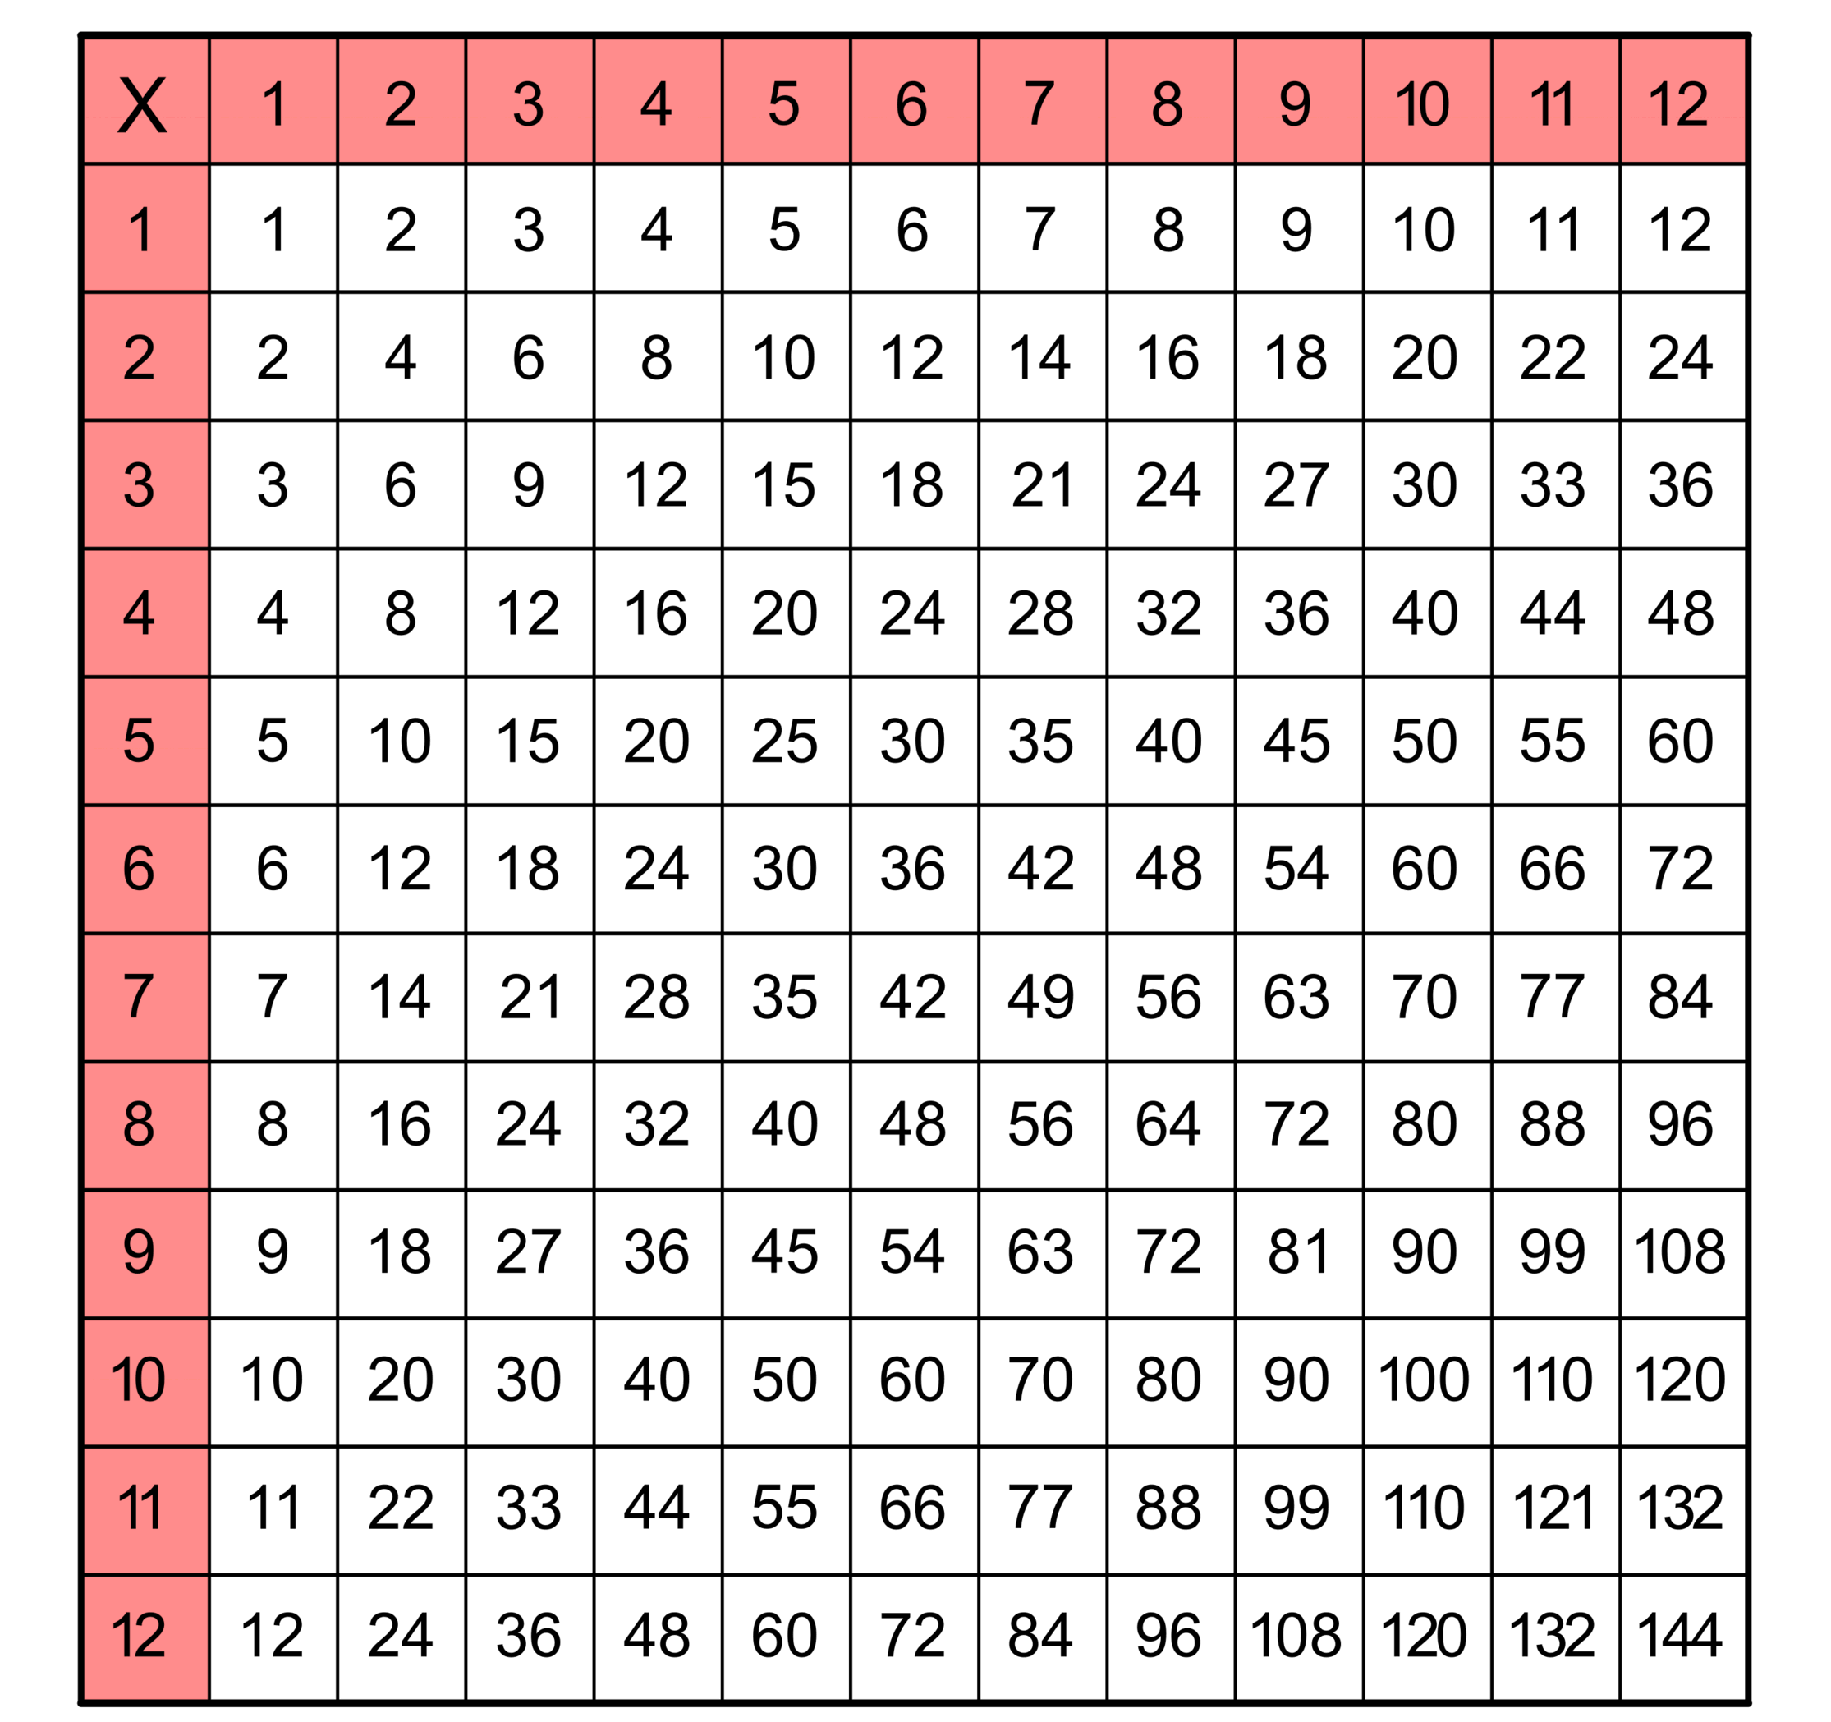
Task: Times Table Generator
Write a C# program using a for loop that asks the user for a number and then prints the multiplication table for that number from 1 to 12.
Challenge:
Use a while loop to keep asking for a new number until the user types 'exit'.

Slide 56
Match the Data!
Initialiser |  | A loop that never exists because the condition is always true.
Iteration |  | A Boolean expression that determines if a loop continues.
Condition |  | The starting value for a loop counter variable.
Infinite Loop |  | A single pass through a group of instructions.

Slide 57
Explain it to a 10 Year Old
One of the biggest dangers of a While loop is creating an Infinite Loop.
Imagine you have to explain what an Infinite Loop is to a 10-year-old. How would you describe it? Mention what causes it and what happens to the computer program as a result.
An infinite loop is like getting stuck on a roundabout and never being able to take the exit.
It happens when the condition to stop the loop never becomes false, so the computer keeps running the exact same code forever.
Eventually, it can cause the program to crash or freeze.

Slide 58
Challenge: The Guessing Game
How would you structure a loop for a game where the user has to guess a secret number between 1 and 100? Would you use a 'for' loop or a 'while' loop? Why?
You might have said...
A while loop is best as we do not know the number of player attempts.
Update a boolean (e.g. isCorrect) inside the loop to end it upon success.
Use a counter inside the loop to track and display the total attempts.

Slide 59
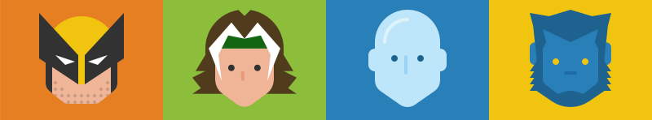
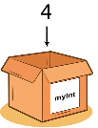
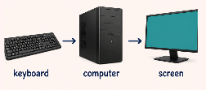
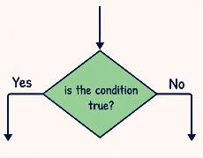

The Core Four
Imagine you are designing the next viral game or a secure bank login system.
At their core, these complex systems rely on just four fundamental building blocks.
Variables
Storing data in memory locations like int score = 10;
I/O
Interacting with users via Console.ReadLine() and Console.WriteLine();
🔑 Key Point
Programming is simply the art of giving a computer a set of instructions to solve a problem.
Selection
Using statements to make decisions based on conditions
Iteration
Using FOR or WHILE loops to repeat code efficiently.

Slide 60
Match the Data!
Variable |  | A data type that can only be true or false.
Selection |  | A named container for data that can change.
Boolean |  | Choosing which code to run based on a condition (IF).
Iteration |  | Repeating a section of code (looping).

Slide 61


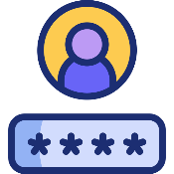
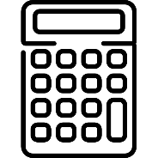

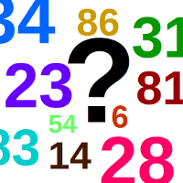
Select Your Project!
Choose one path to demonstrate your C# skills using the core concepts like variables and loops.
Greeting Bot
Ask for a name and age, then give a personalised welcome message.
Login System
Compare a user's input against a stored password and grant or deny access.
Simple Calculator
Take two numbers and perform +,-,*, on them together using basic arithmetic
Fitness Tracker
Input daily steps and use a loop to calculate total steps over a week.
Number Guessing
Check if a user’s input matches a secret number using an if-statement.

Slide 62
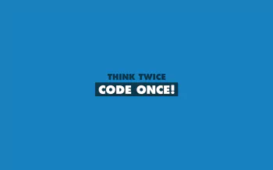
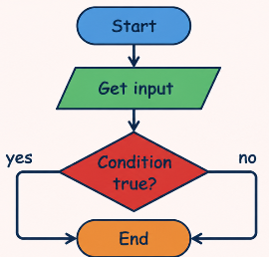
STEP 1: The Planning Phase
⚠️ Watch Out!
Starting code without a plan often leads to ‘spaghetti code’ that is hard to fix later.
Flowcharting
Don't touch the keyboard yet! Sketch your program flow.
Where does the loop start?
What condition triggers the IF statement?
What variables do you need?

Slide 63

STEP 2: Building Iteratively
Code, Test, Repeat
Setup: Declare your variables first.
Input: Get the basic interaction working.
Logic: Add your IF statements.
Loop: Wrap your code in a loop last to avoid infinite loop errors during testing.

Slide 64
Clean Code Matters
Developers spend more time reading code than writing it. Your work is graded on readability.
Indentation
Keep code nested inside curly braces
Naming
Use meaningful names like number1 instead of xfgdfgdfgds or var1
Comments
Use // to explain complex logic

Slide 65

Review!
Swap seats with a partner. Try to 'break' their program by entering unexpected inputs (e.g., typing letters when it asks for numbers).
Give Feedback:
Does the loop end correctly?
Are the IF statements logical?
Is the code easy to read?

Slide 66

Final Review
Which of the four core skills (Variables, I/O, Selection, Iteration) did you find most challenging to implement in your project, and how did you overcome it?

